Slide 1
Active Contour Model
Digital Image Processing
In-class Exercise 17
Shwet Shah (800904562)

Slide 2
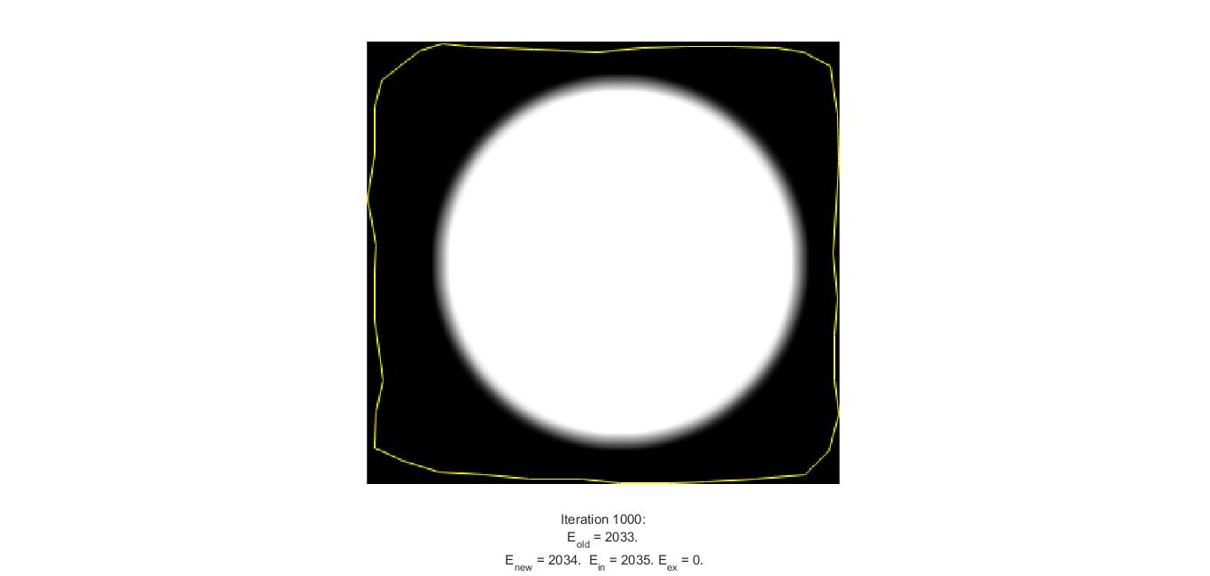
Criterion 1 - For iteration 1k

Slide 3
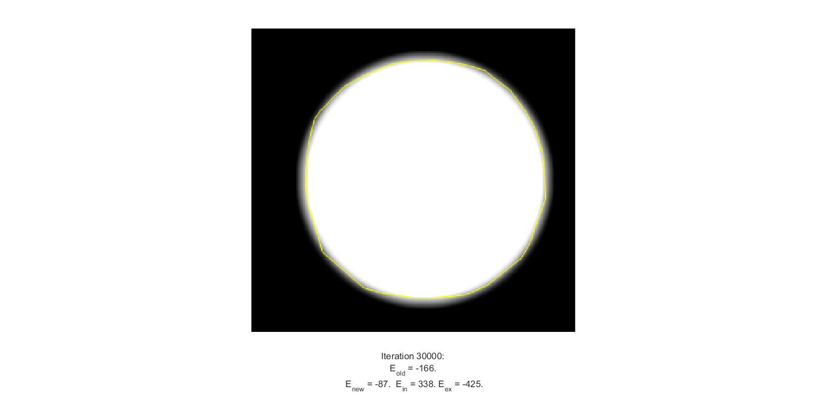
Criterion 2 - For iteration 30k

Slide 4

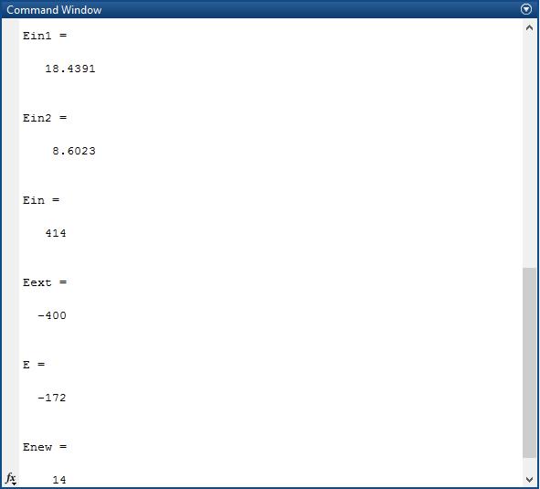
Criterion 3 - For iteration 100k

